Slide 1

Anomaly & Fraud Detection Credit card from customer’s factors
There is 1 Impostor among us

Slide 2
Table of Contents
01
02
03
04
EDA
Evaluation Model
Describe the factors Of Fraud & Not Fraud
Steps for management the data and evaluate the models
Result
Conclusion
Which models are the best for evaluation
Recommend and conclude the factors of Fraud data

Slide 3
Problem Statements
Which factors or behavior of fraudulent customer.
To classify and predict new transaction automatically.
Which models are the best efficient to predict fraud.

Slide 4
Size of data set
590,540 x 434
This data is brought from IEEE Computational Intelligence Society (IEEE-CIS) for detection of fraud and not fraud of credit card customer in Kaggle.

Slide 5
Explore the Data
No Fraud
Fraud !!
From the data, there are not fraud about 96.50%
Only 3.50% are fraud !

Slide 6
Data Description
Features | Description
TransactionDT | Timedelta from a given reference datetime.
TransactionAMT | Transaction payment amount in USD.
ProductCD | Product code, the product for each transaction.
Card1 - Card6 | Payment card information, such as card type, card category, issue bank, country, etc.
Addr | Address
Dist | Distance
P_ and (R__) emaildomain | Purchaser and recipient email domain.
C1-C14 | Counting, such as how many addresses are found to be associated with the payment card, etc. The actual meaning is masked.
D1-D15 | Timedelta, such as days between previous transaction, etc.
M1-M9 | Match, such as names on card and address, etc.
Vxxx | Vesta engineered rich features, including ranking, counting, and other entity relations.

Slide 7
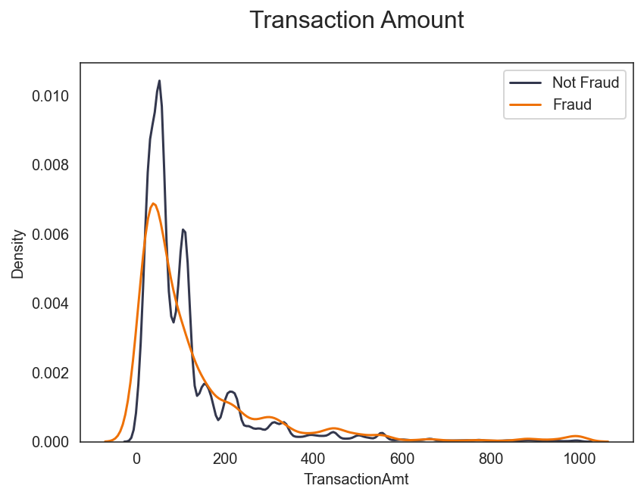
Distribution of the Transaction Amount

Slide 8
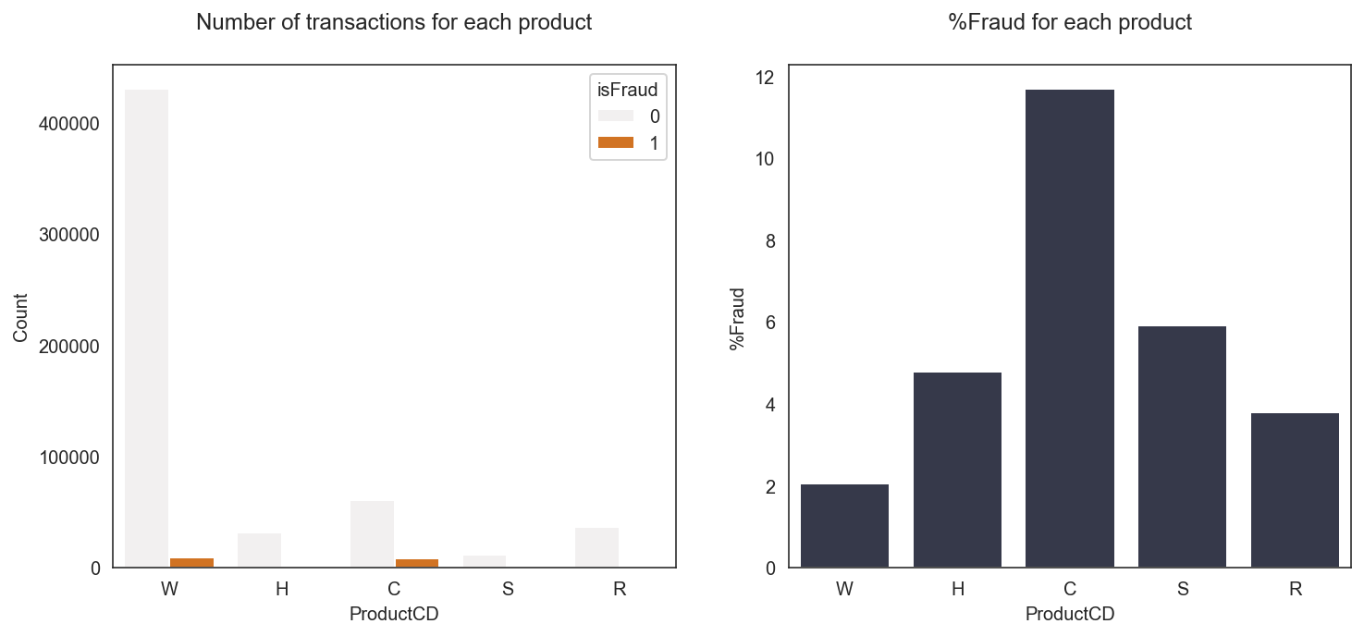
Explore the data (product cd)

Slide 9
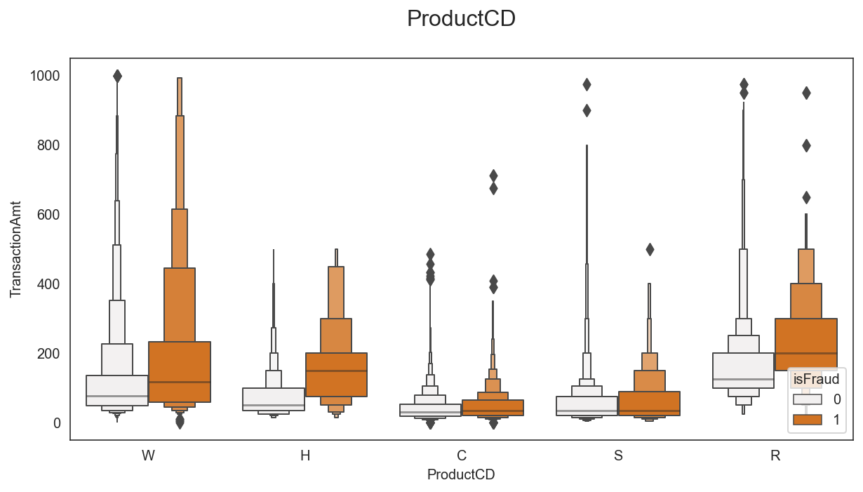
Behavior of customer by transaction amount

Slide 10
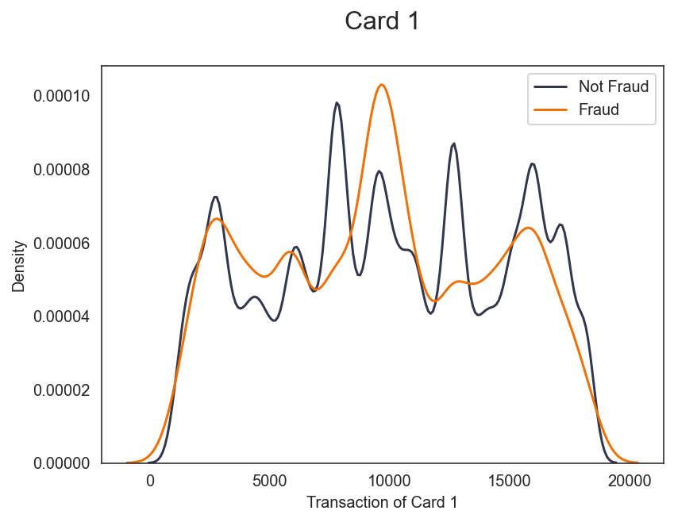
Explore the data (card 1-6)
Card 1

Slide 11
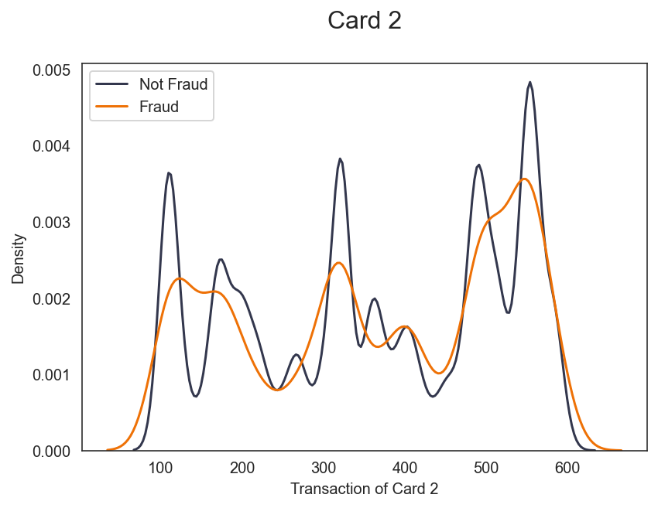
Explore the data (card 1-6)
Card 2

Slide 12
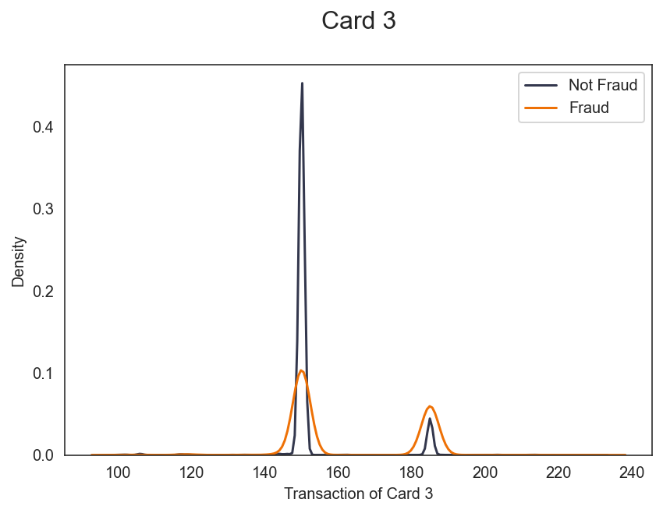
Explore the data (card 1-6)
Card 3

Slide 13
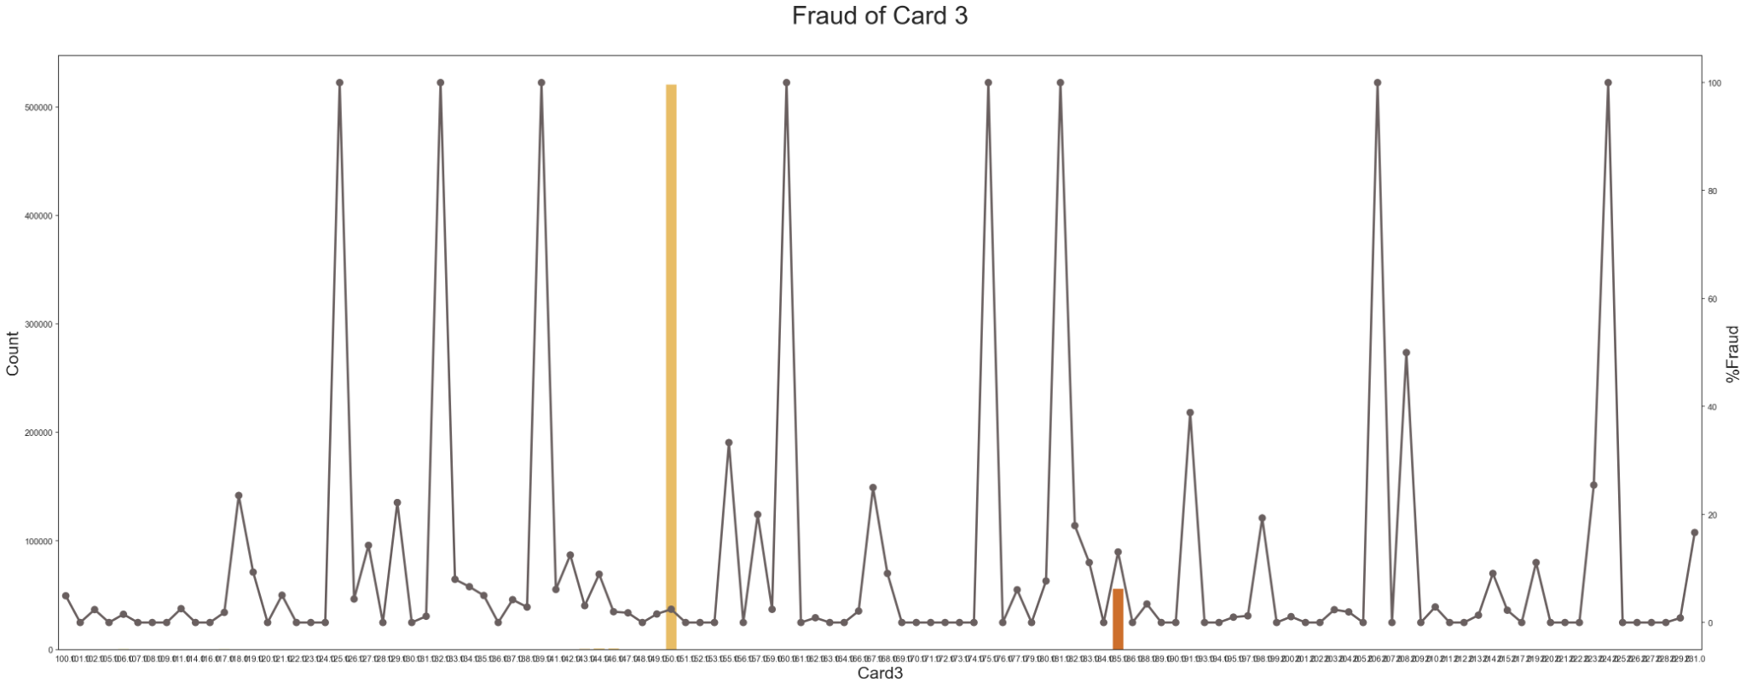
%Fraud of card 3

Slide 14
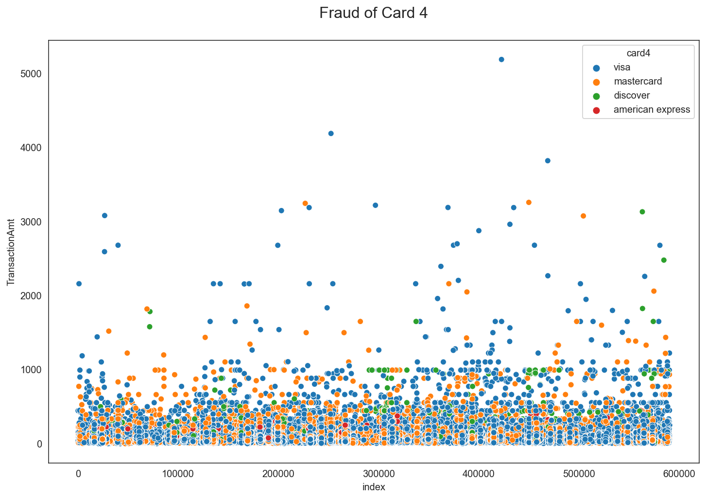
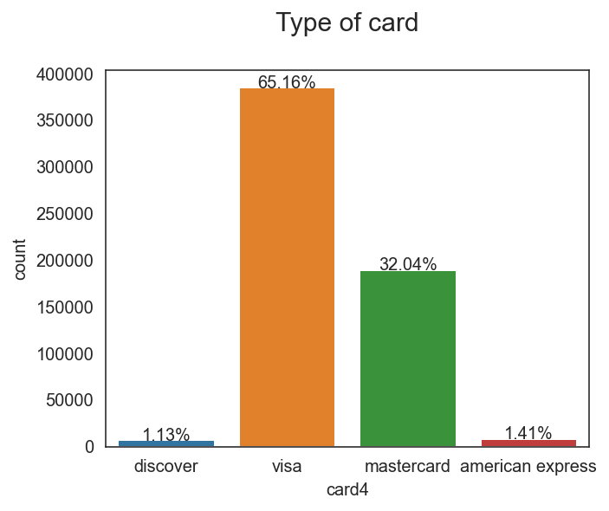
Explore the data (card 1-6)
Card 4
Total count of Card 4
Discover: 1.13%
Visa: 65.16%
Mastercard: 32.04%
American Express: 1.41%

Slide 15
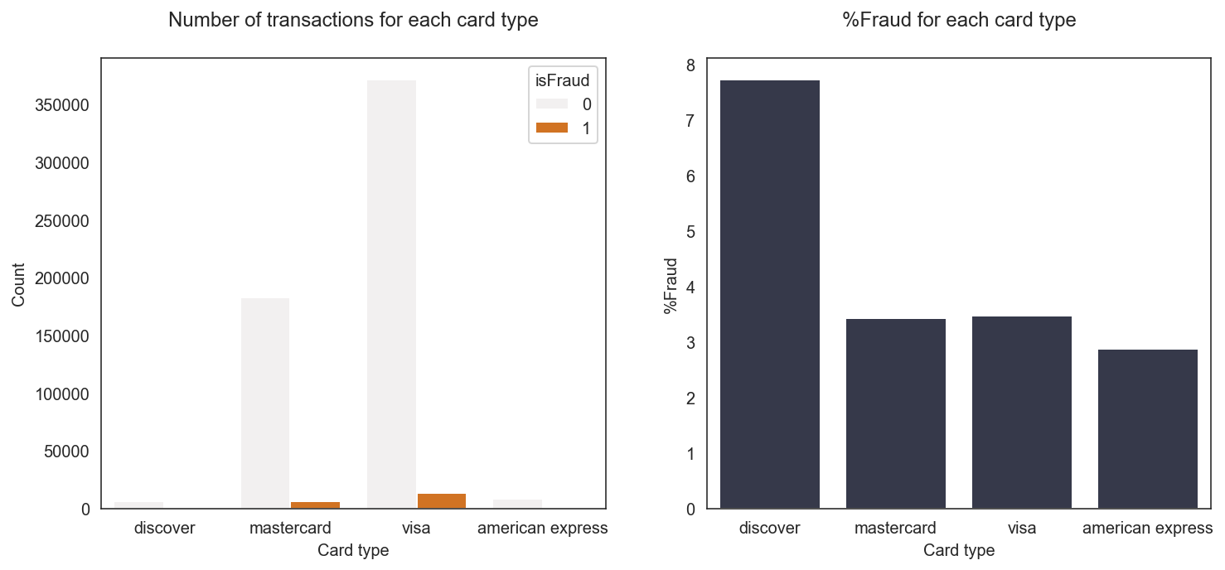
Explore the data (card 4)

Slide 16
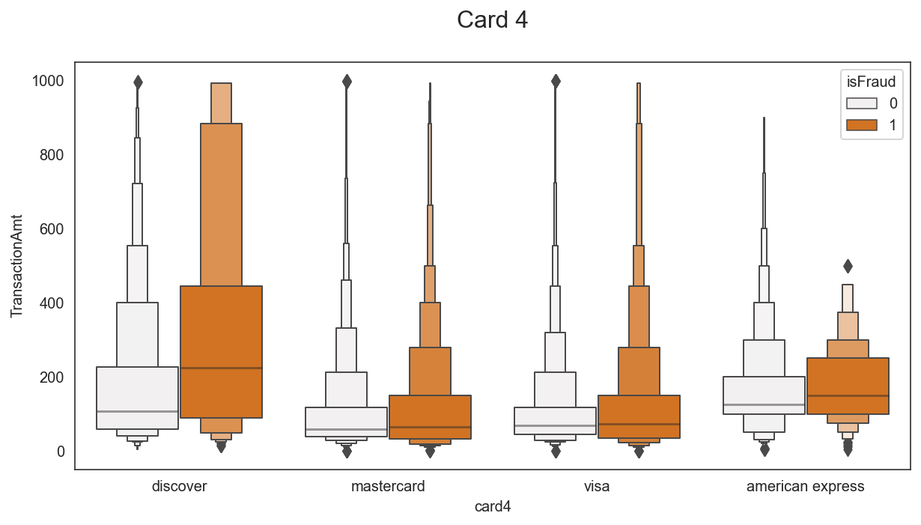
Behavior of customer by transaction amount

Slide 17
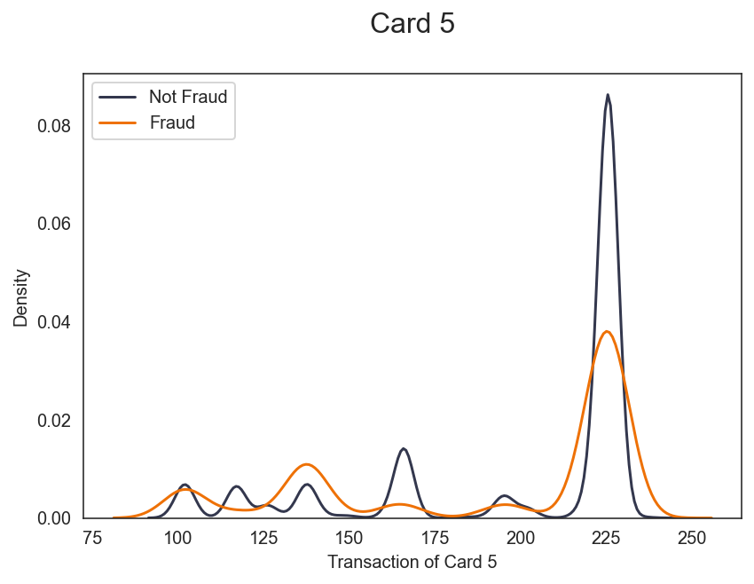
Explore the data (card 1-6)
Card 5

Slide 18
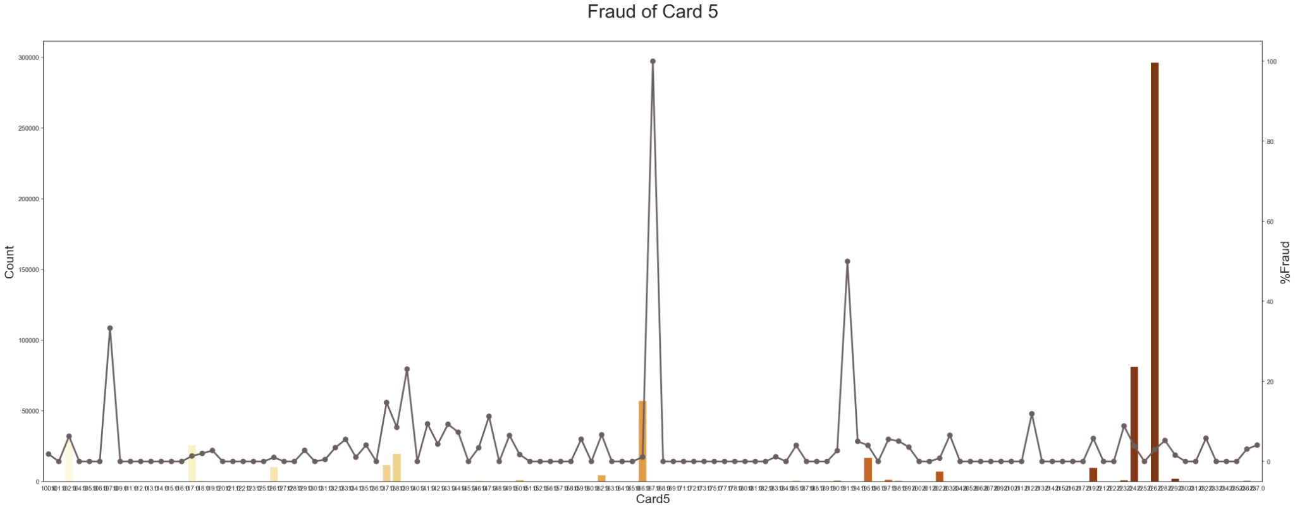
%Fraud of card 5

Slide 19
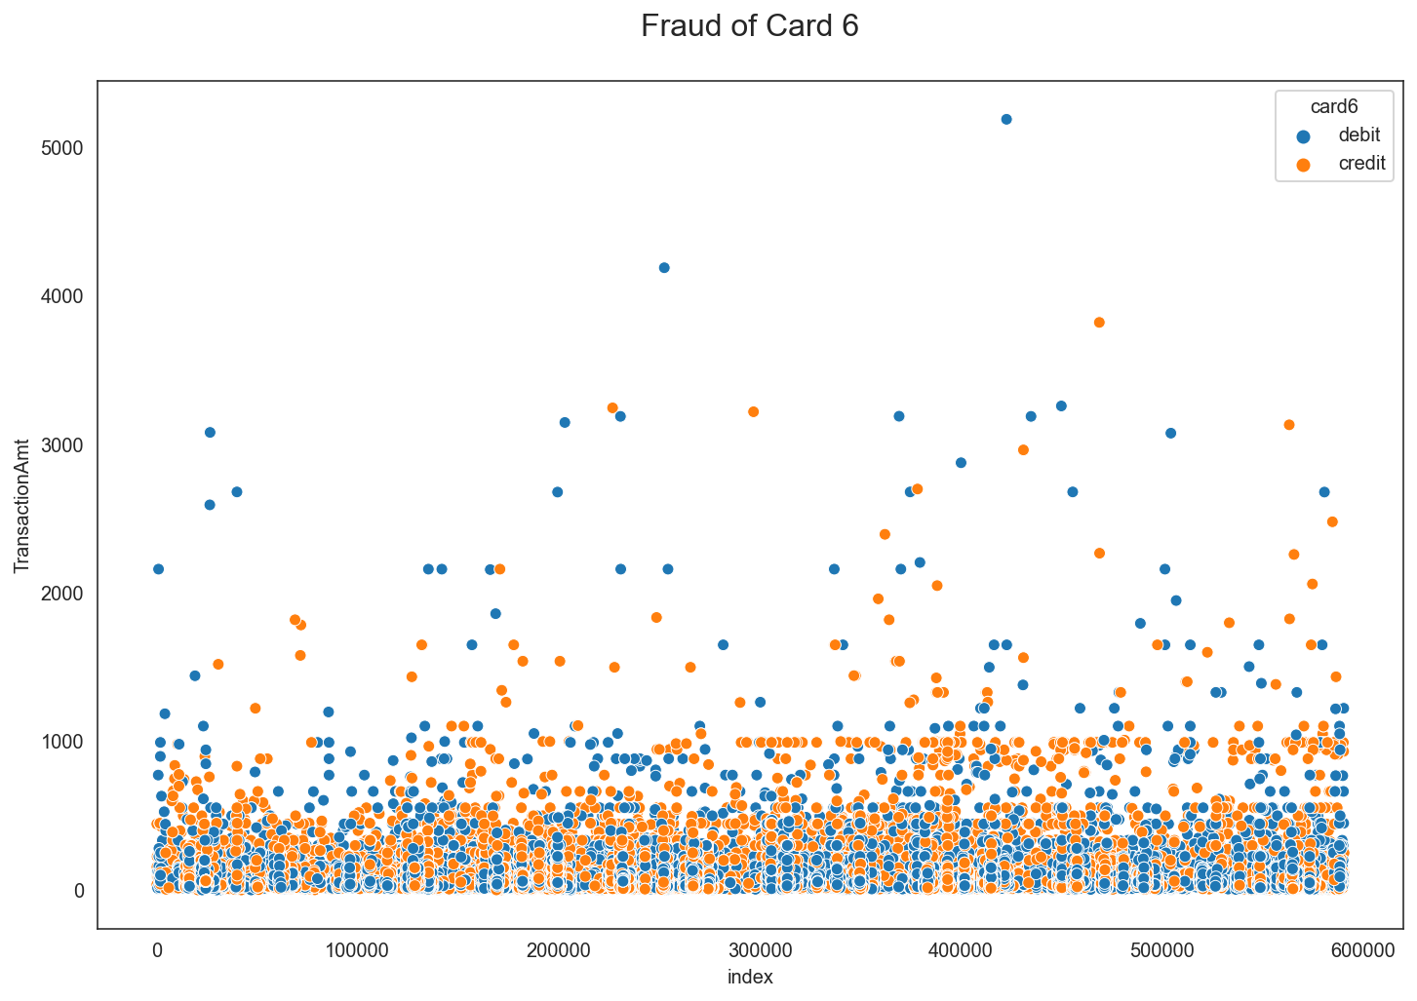
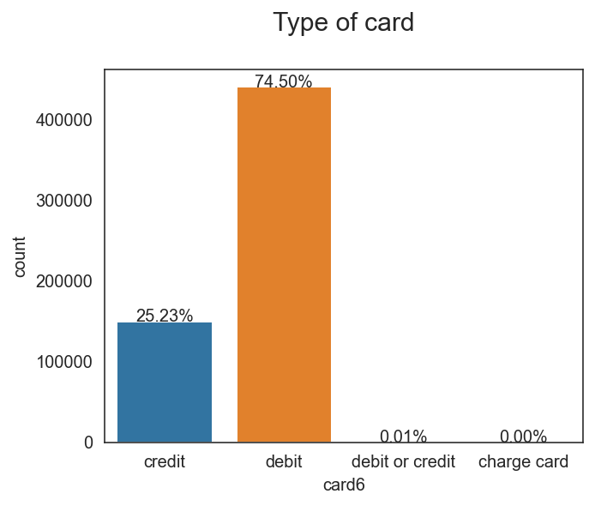
Explore the data (card 1-6)
Card 6
Total count of Card 6
Credit: 25.23%
Debit: 74.50%
Debit/Credit: 0.01%
Charge Card: 0.00%

Slide 20
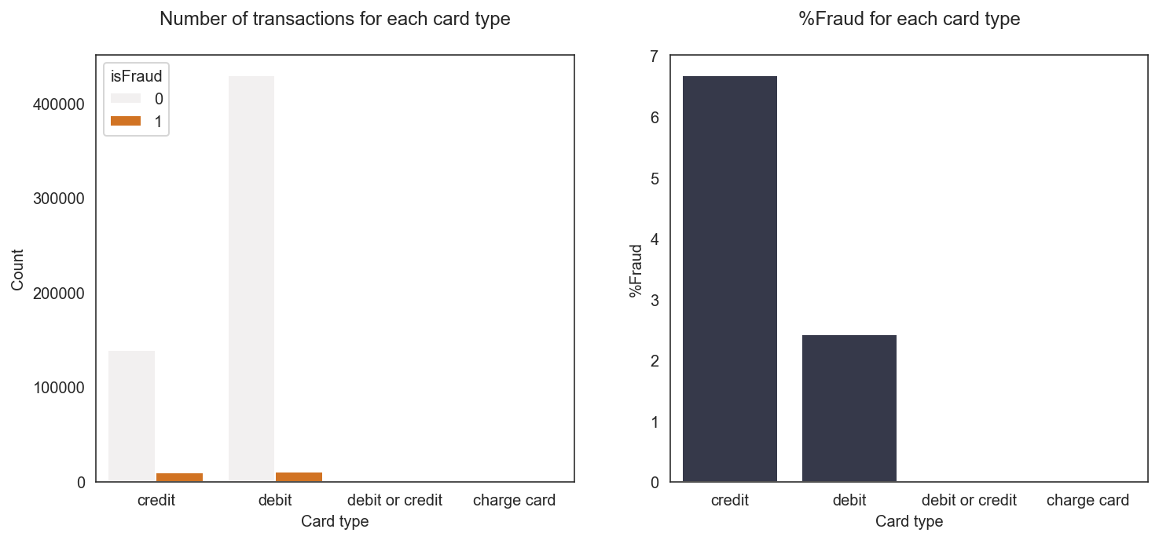
Explore the data (card 6)

Slide 21
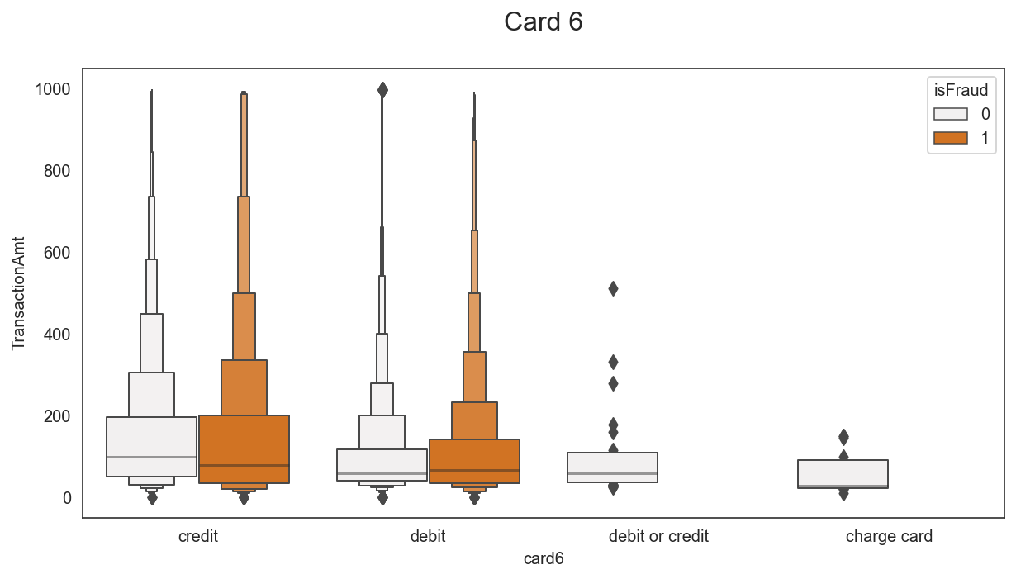
Behavior of customer by transaction amount

Slide 22
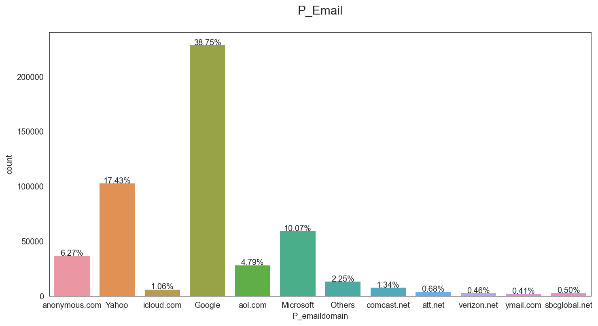
Explore the data (P_Email)
This graph is the ratio for each type of email. The popular email is ‘Google’.
There are 59 types of email. They are grouped into 4 groups are ‘Google’, ‘Yahoo’, ‘Microsoft’ and ‘Others’. ‘Others’ is the group of emails that has more than 2000 email’s customers.

Slide 23
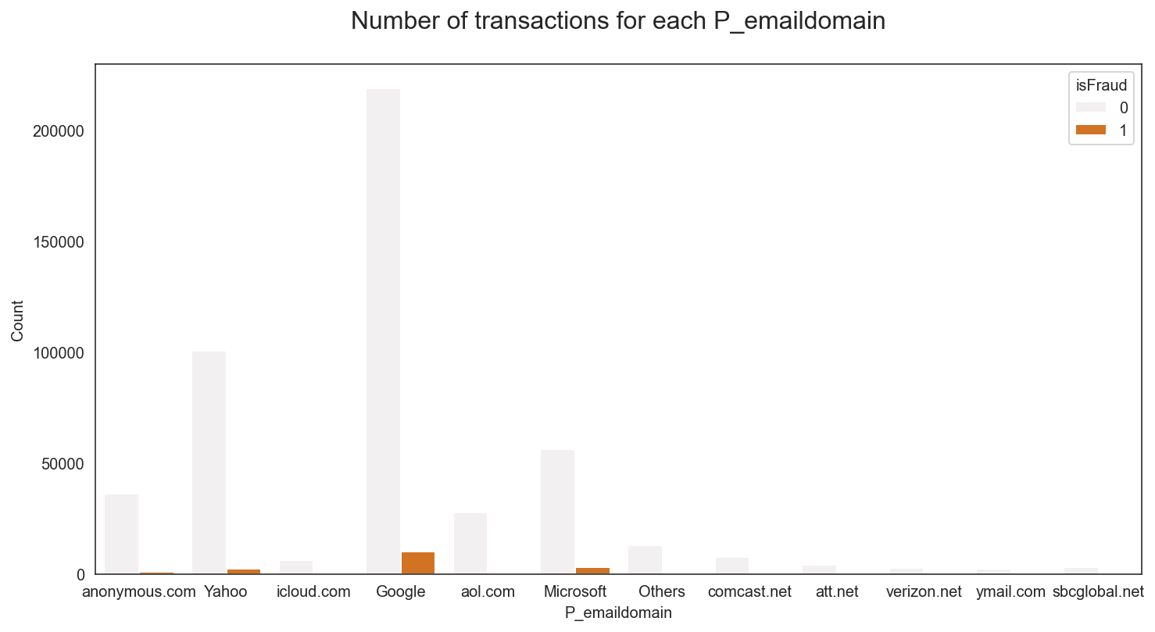
Explore the data (P_emaildomain)

Slide 24
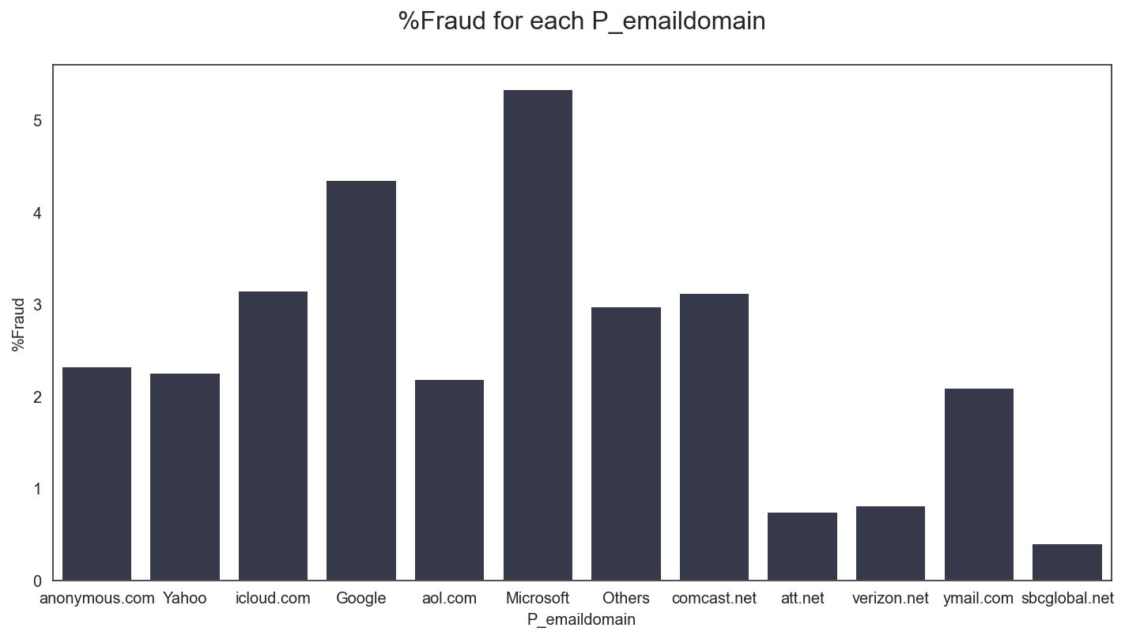
Explore the data (P_emaildomain)

Slide 25
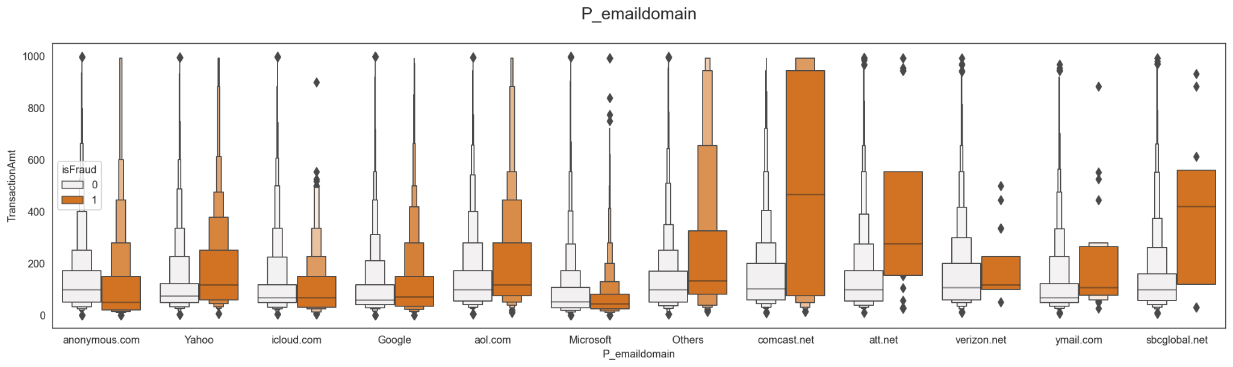
Behavior of customer by transaction amount

Slide 26
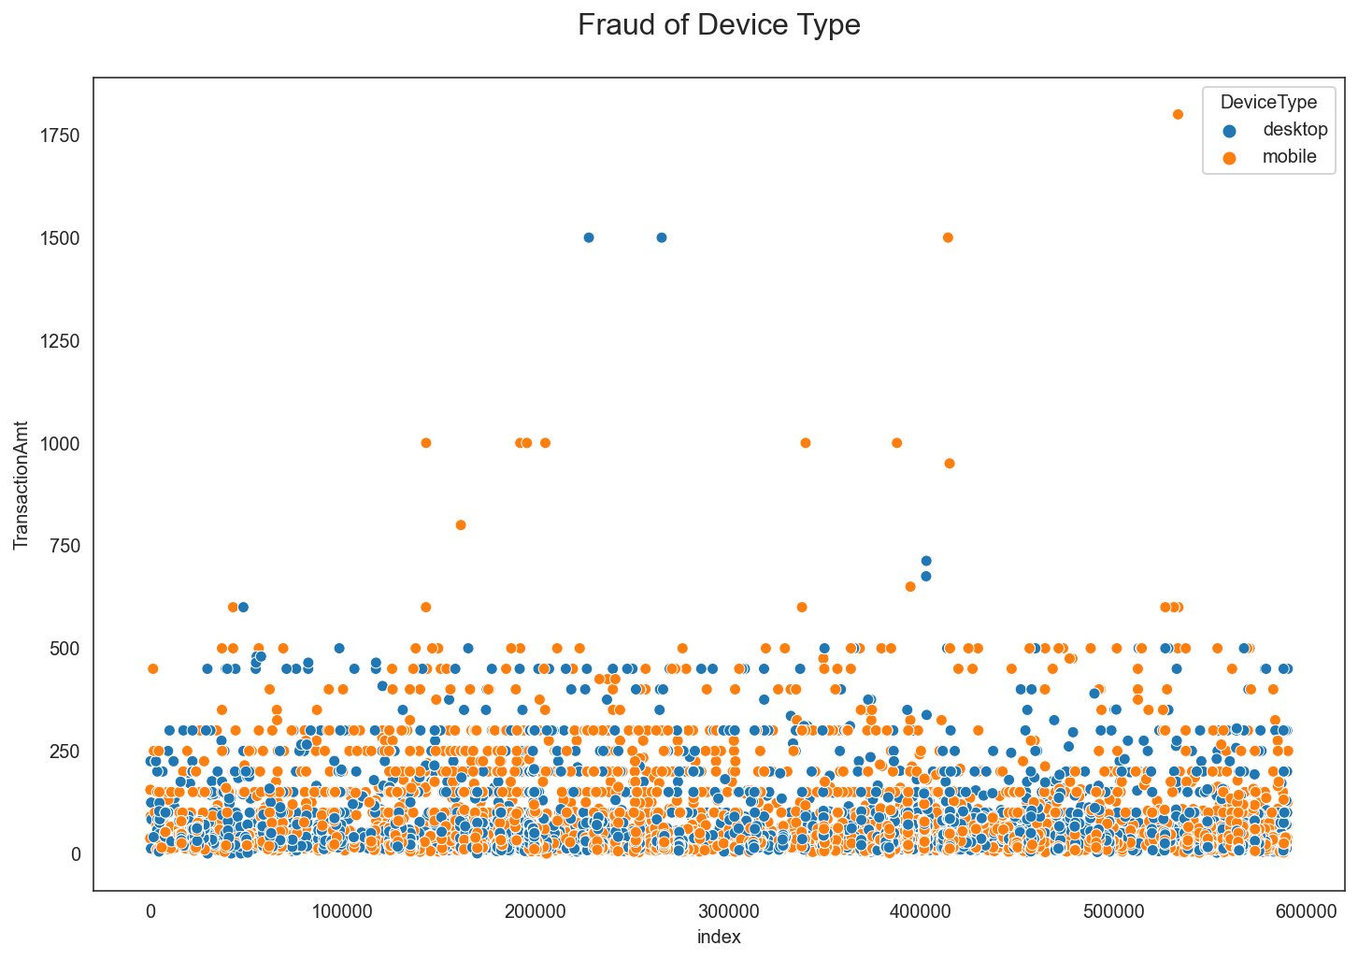
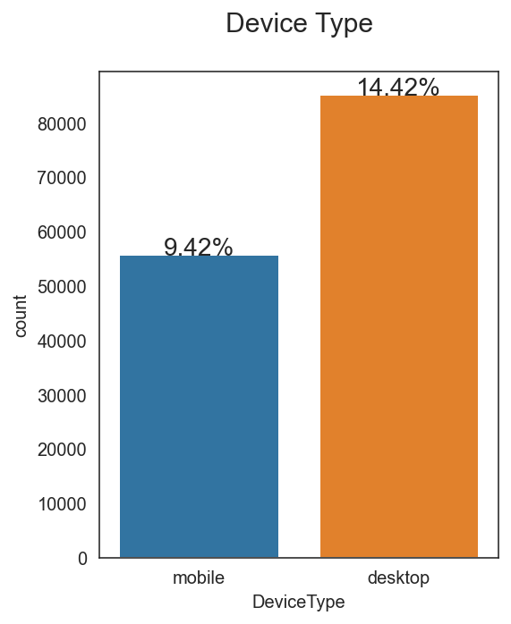
Explore the data (Device Type)
Total count of device type - Mobile: 9.42% - Desktop: 14.42% - Null value: 76.16%

Slide 27
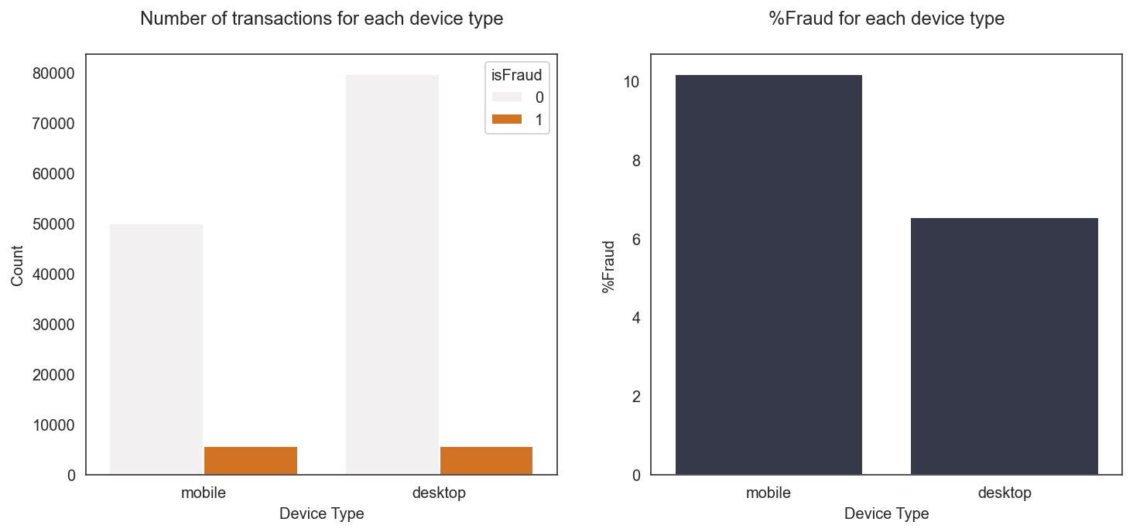
Explore the data (Device Type)

Slide 28
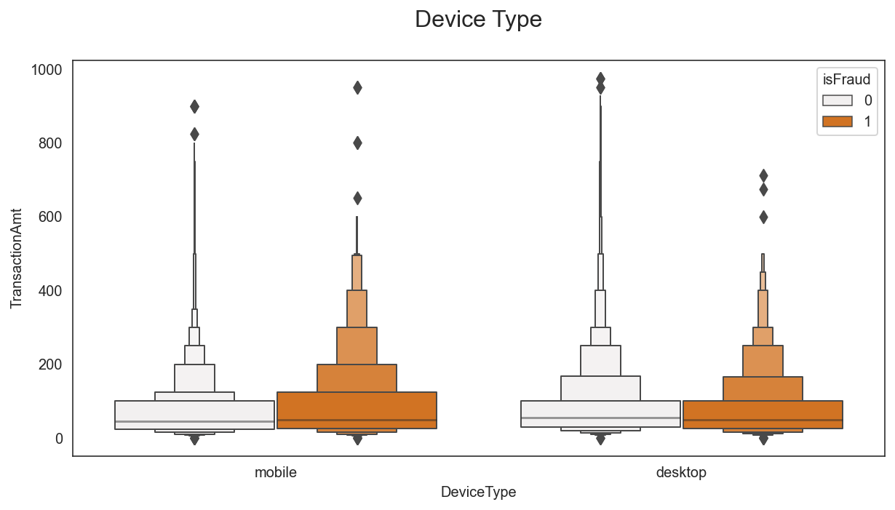
Behavior of customer by transaction amount

Slide 29
02
Evaluation Models
Train size: 455,920
Validation size: 118,108
Test size: 506,691

Slide 30
Whoa!
We will find the probability of which customers are fraud by our models
Decision Tree
RandomForest
Gradient Boosting
AutoEncoder

Slide 31
Steps for prediction fraud
EDA & Cleaning the data by grouping the email, fill null value by mode and OneHotEncoding.
Bring the data into the models
Supervise: DecisionTree, RandomForest and GradientBoosting
Unsupervise: AutoEncoder
Summary and comparison the models.
Step 1
Step 3
Step 5
Step 2
Step 4
Using SMOTE to solving the imbalance data and PCA for decreasing dimension of the model.
Evaluate models by ROC curve, AUC score, accuracy, precision, recall, misclassification and specificity

Slide 32
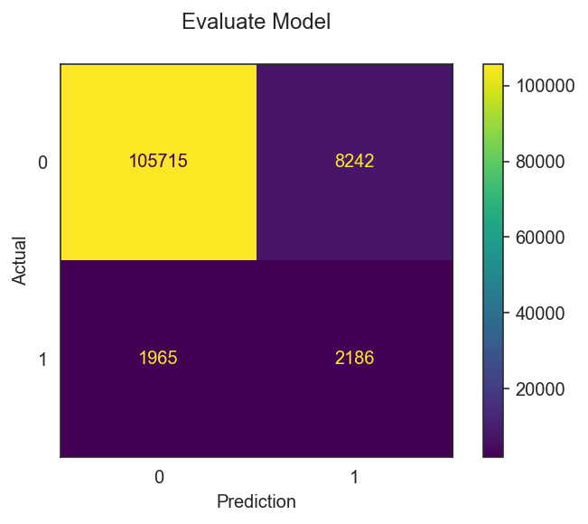
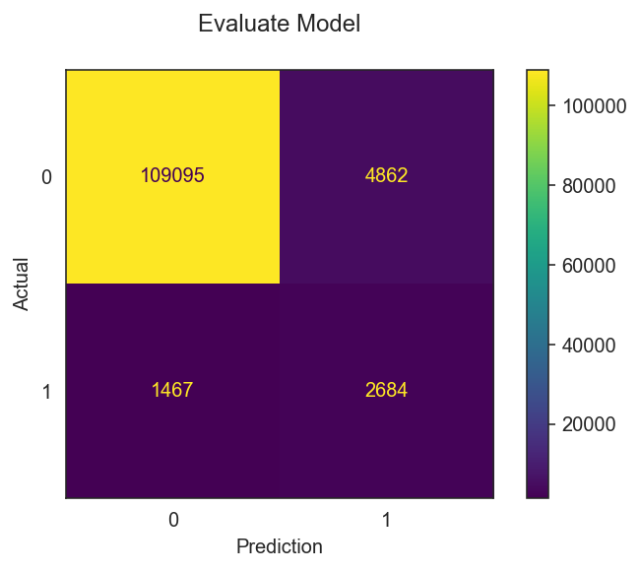
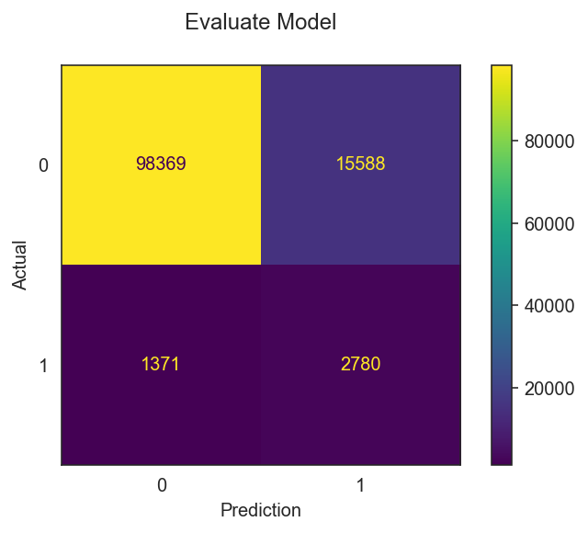
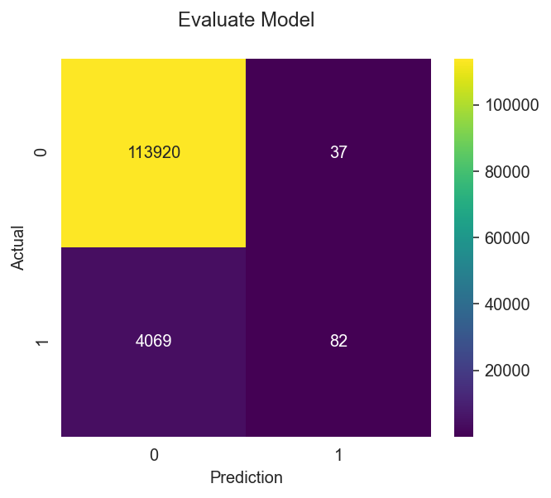
Confusion Matrix
DecisionTree
RandomForest
- TP = 2,186 - TN = 105,715 - FP = 2,186 - FN = 1,965 - Accuracy: 91.36% - Misclassification: 8.64% - Precision: 20.96% - Recall: 52.66% - Specificity: 92.77%
- TP = 2,684 - TN = 109,095 - FP = 4,862 - FN = 1,467 - Accuracy: 94.64% - Misclassification: 5.36% - Precision: 35.57% - Recall: 64.66% - Specificity: 95.73%
GradientBoosting
AutoEncoder (Threshold = 99.9%)
- TP = 2,780 - TN = 98,369 - FP = 15,588 - FN = 1,371 - Accuracy: 85.64% - Misclassification: 14.4% - Precision: 15.14% - Recall: 66.97% - Specificity: 86.32%
- TP = 82 - TN = 113,920 - FP = 37 - FN = 4,069 - Accuracy: 96.52% - Misclassification: 3.48% - Precision: 68.91% - Recall: 1.98% - Specificity: 99.97%

Slide 33
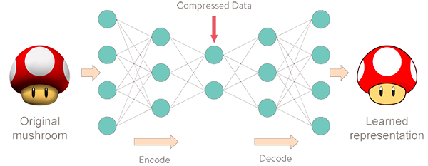
Auto Encoder

Slide 34
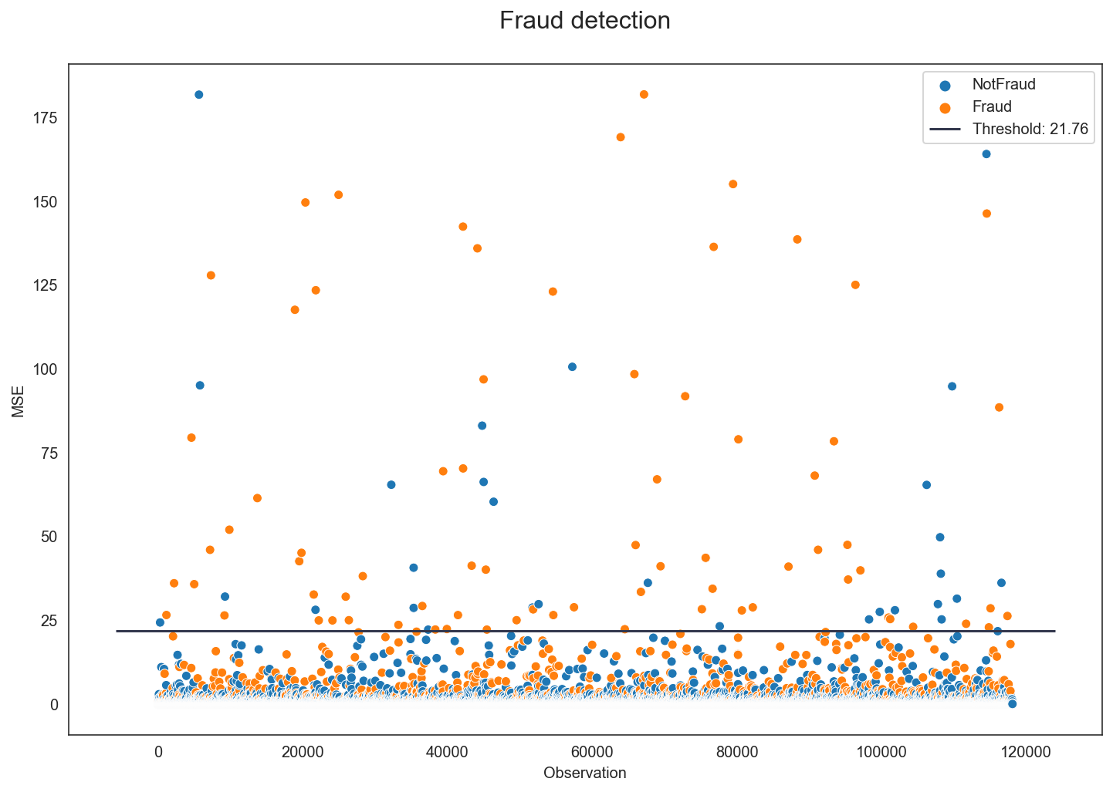
Adjust Threshold (Auto ENcoder)
Threshold = Percentile 99.9
TP
FP
- TP = 82 - TN = 113,920 - FP = 37 - FN = 4,069 - Accuracy: 96.52% - Misclassification: 3.48% - Precision: 68.91% - Recall: 1.98% - Specificity: 99.97%
FN
TN

Slide 35
Result from evaluation model
Model | TP | TN | FP | FN | Accuracy | Misclassification | Precision | Recall | Specificity
AutoEncoder
Thres 90.0% | 1,894 | 103,885 | 10,072 | 2,257 | 89.56% | 10.44% | 15.83% | 45.63% | 91.16%
Thres 96.5% | 1,147 | 110,997 | 2,960 | 3,004 | 94.95% | 5.05% | 27.93% | 27.63% | 97.40%
Thres 99.0% | 546 | 113,326 | 631 | 3,605 | 96.41% | 3.59% | 46.39% | 13.15% | 99.45%
Thres 99.5% | 332 | 113,698 | 259 | 3,819 | 96.55% | 3.45% | 56.18% | 8.00% | 99.77%
Thres 99.9% | 82 | 113,920 | 37 | 4,069 | 96.52% | 3.48% | 68.91% | 1.98% | 99.97%
Decision Tree | 2,186 | 105,715 | 2,186 | 1,965 | 91.36% | 8.64% | 20.96% | 52.66% | 92.77%
Random Forest | 2,684 | 109,095 | 4,862 | 1,467 | 94.64% | 5.36% | 35.57% | 64.66% | 95.73%
Gradient Boosting | 2,780 | 98,369 | 15,588 | 1,371 | 85.64% | 14.4% | 15.14% | 66.97% | 86.32%

Slide 36
Testing in Kaggle
Comparison 4 models with AUC score in Kaggle
DecisionTree AUC Score: 69.26%
RandomForest AUC Score: 88.79%
GradientBoosting AUC Score: 88.90%
AutoEncoder AUC Score: 78.23%

Slide 37
Conclusion
Fraudulent transactions spend a little money but many times.
The transaction with product C, Discover card, credit card, Microsoft email and use a mobile have more probable to be a fraudulent transactions.
The best model to predict probability of fraud or not fraud for this data set is Gradient Boosting.
Each company has the different criteria to detect fraud so, we can adjust the suitable threshold from the model’s prediction.
Transaction payment amount, Card1, Card2, Card3, and Card5 are the important features for prediction fraudulent transaction.

Slide 38
Thanks!
Do you have any questions?

